Slide 1



AEROPINN
BY TEAM: THE HUSTLERS(254)
SIDDHARTH PATEL
SARTHAK CHAUHAN
ROHAN SINGH
HARISH SIVAKUMAR

Slide 2
PROBLEM STATEMENT
Leveraging Physics-Informed Neural Network(PINN) to simulate airflow patterns around arbitrary geometries(AirFoils).

Slide 3
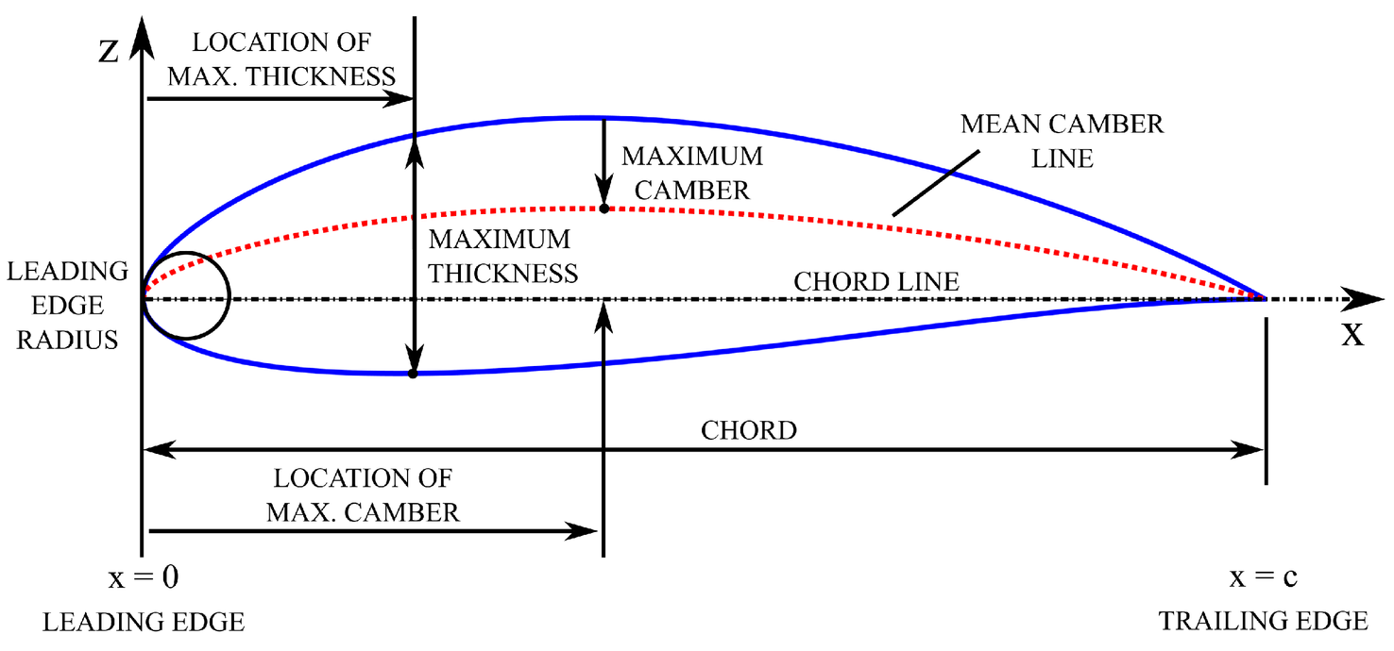
WHAT IS AIRFOIL
An airfoil is a streamlined shape designed to produce lift and minimize drag as air flows around it.

Slide 4
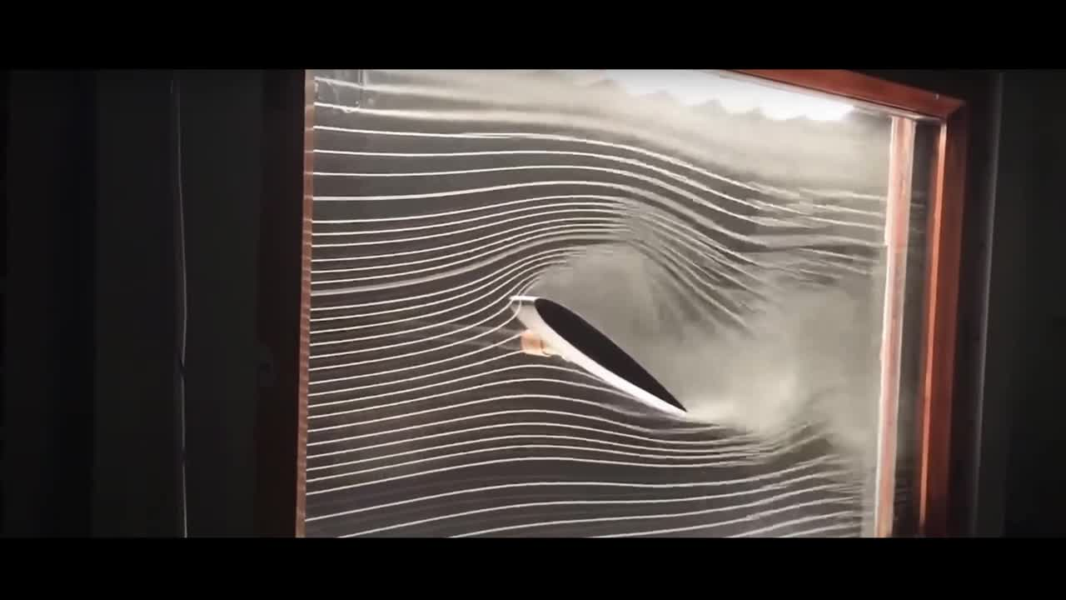
aiRFOIL SIMULATION

Slide 5
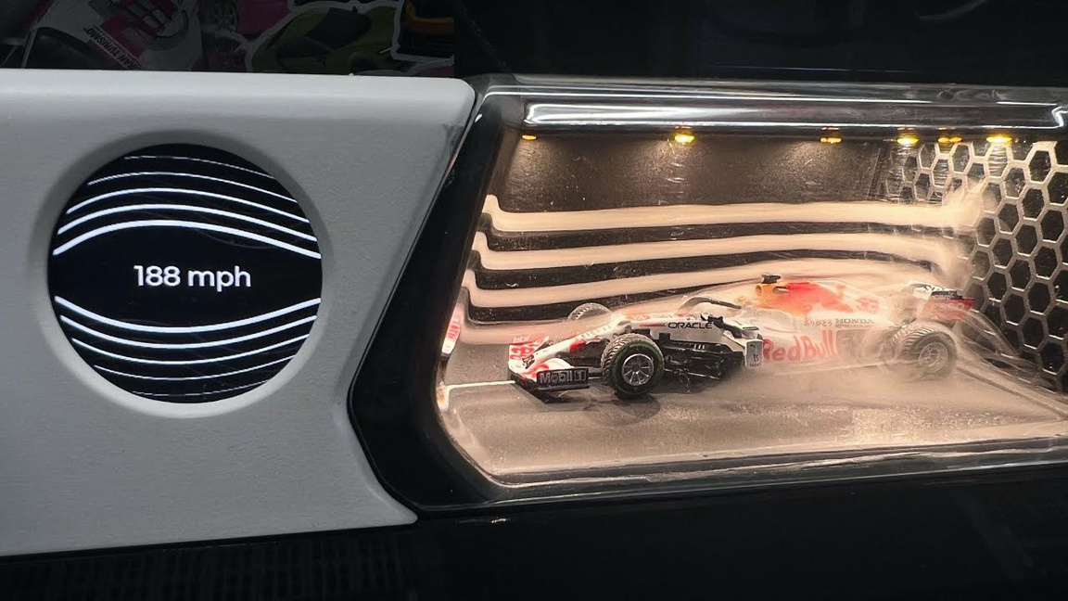
TRADITIONAL SOLUTION
Use Computational Fluid Dynamics (CFD) simulations
Requires mesh generation and boundary condition setup

Slide 6
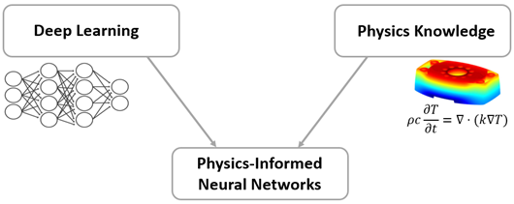
WHAT IS PINN
“Marry the adaptability of neural networks with the rigor of physics.”
--George Em Karniadakis
It's about creating AI that's both flexible and grounded in scientific principles.

Slide 7

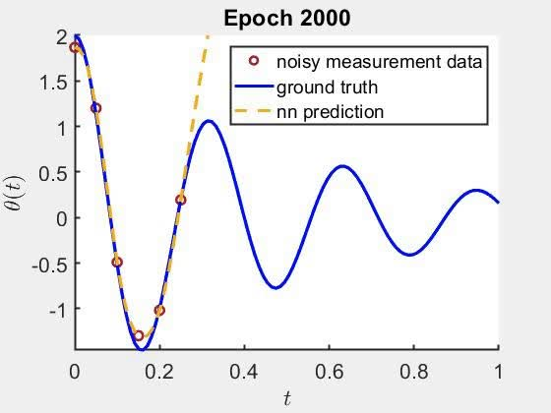
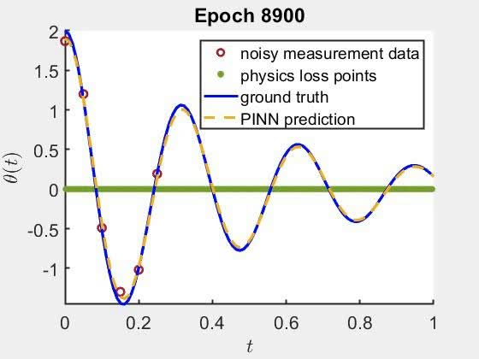
HOW PINNS DIFFER FROM TRADITIONAL NEURAL NETWORKS
Simple Neural Network
Physics Informed Neural Network

Slide 8
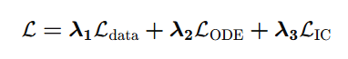
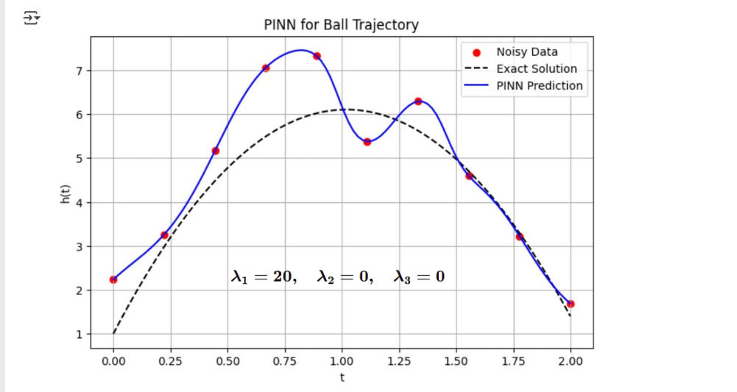
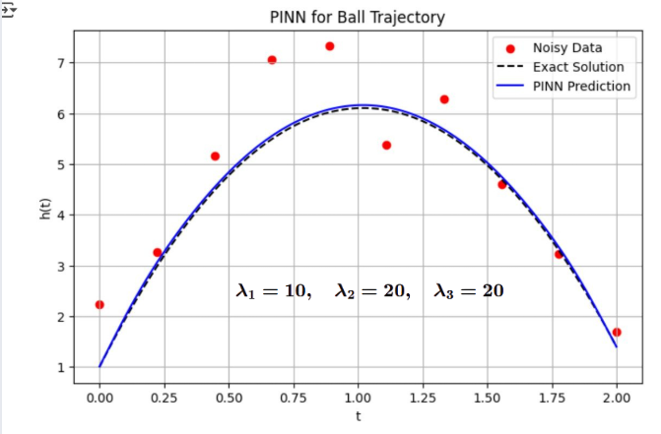
PINN USING PROJECTILE EQUATION
Loss Function

Slide 9

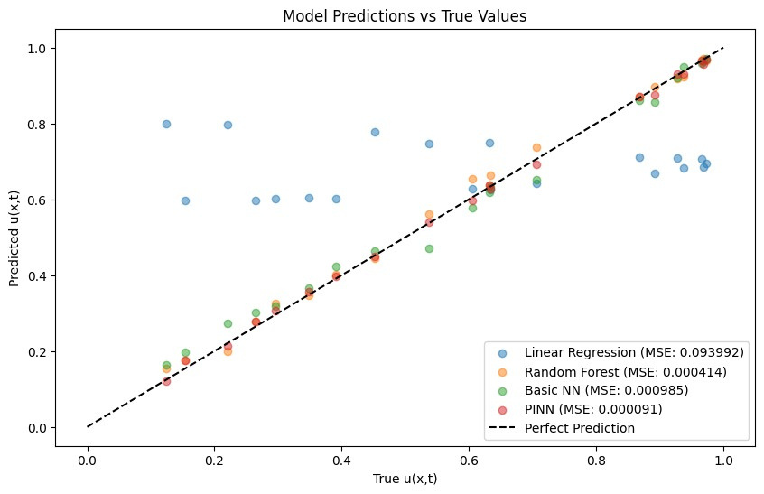
PINNS IN REGRESSION

Slide 10
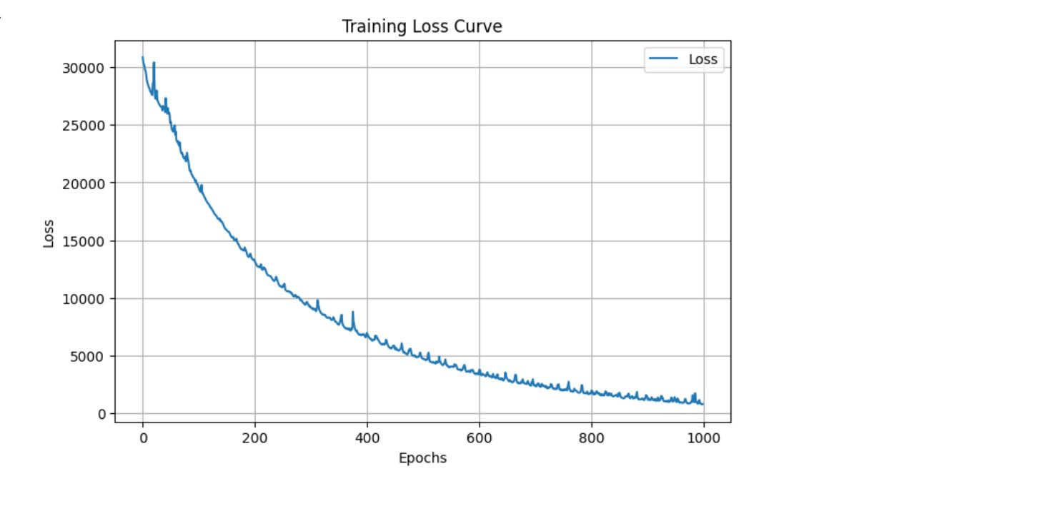
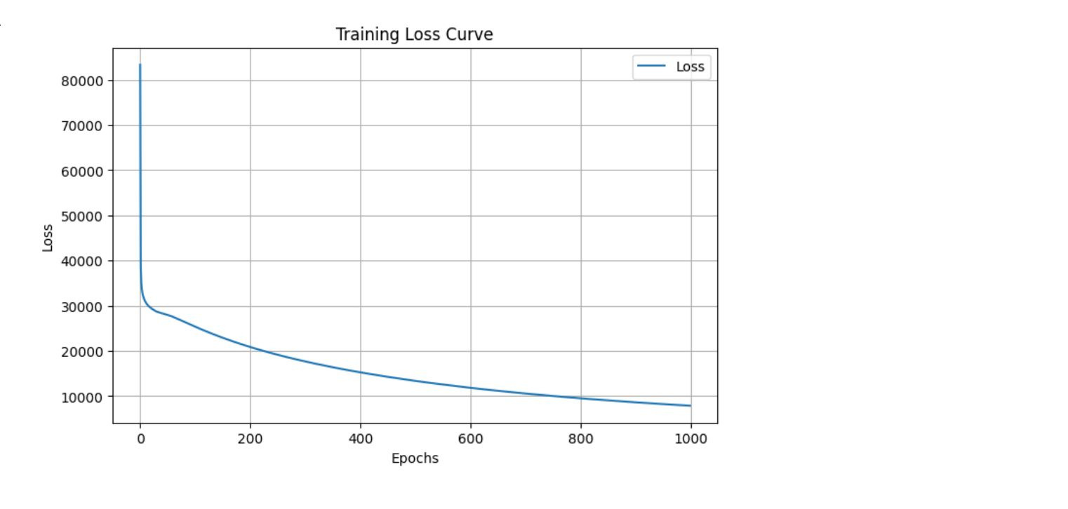

TRAIN LOSS
USING PINN
NO PINNs

Slide 11
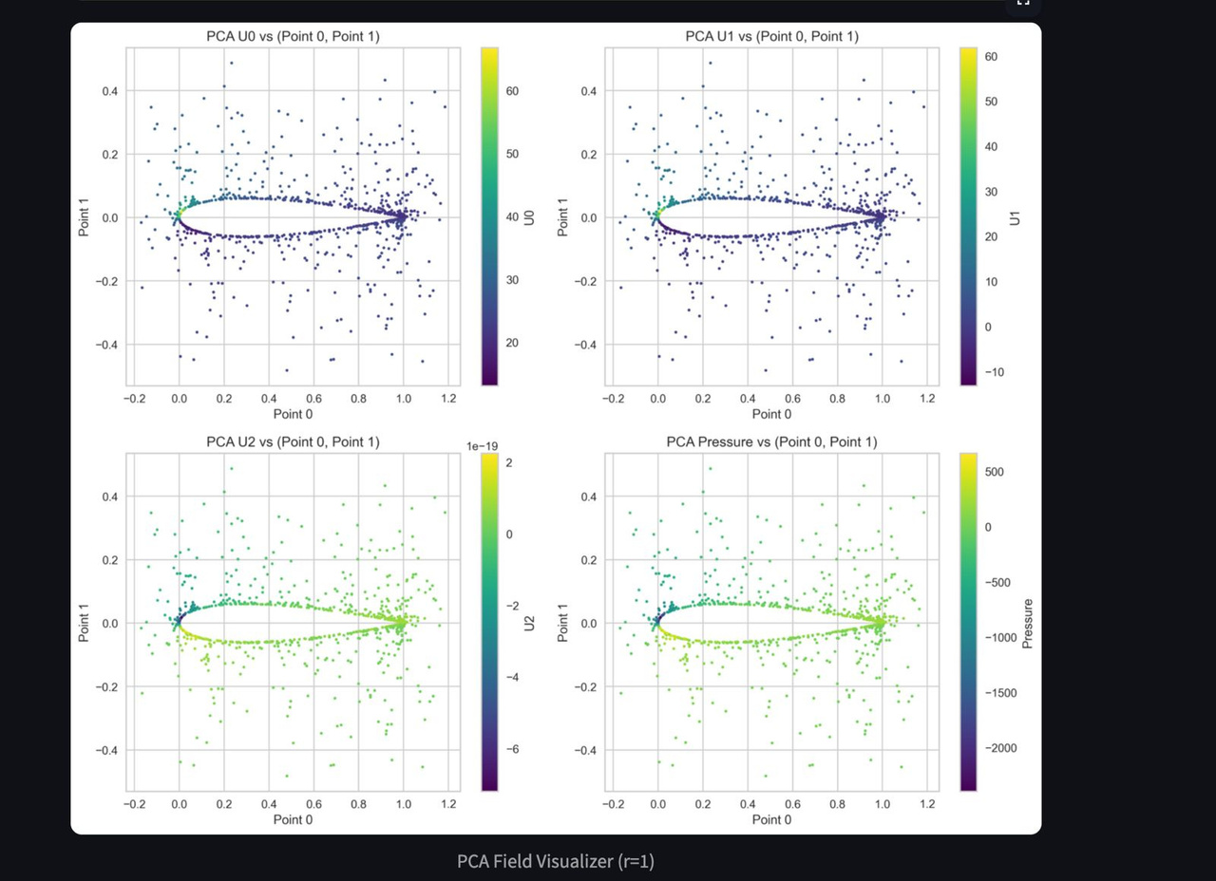
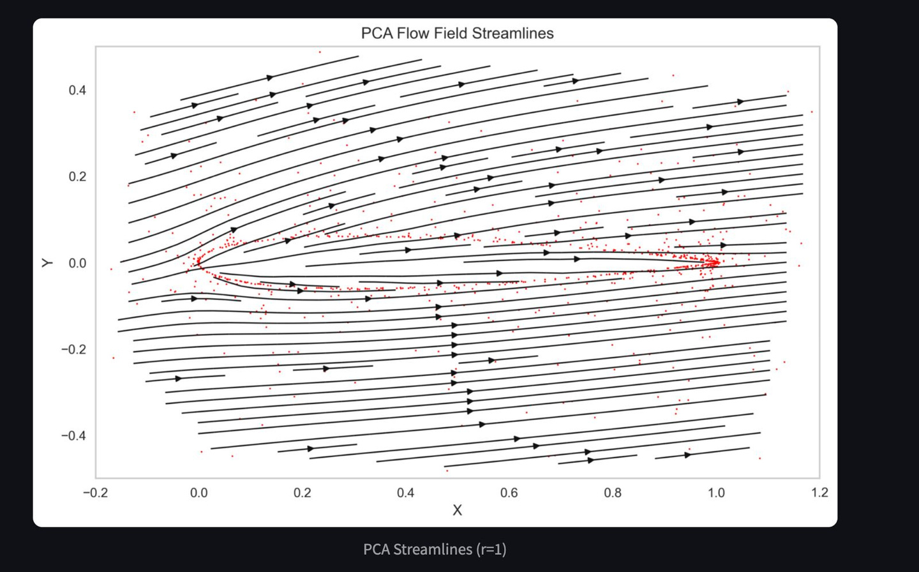
INITIAL DATA

Slide 12
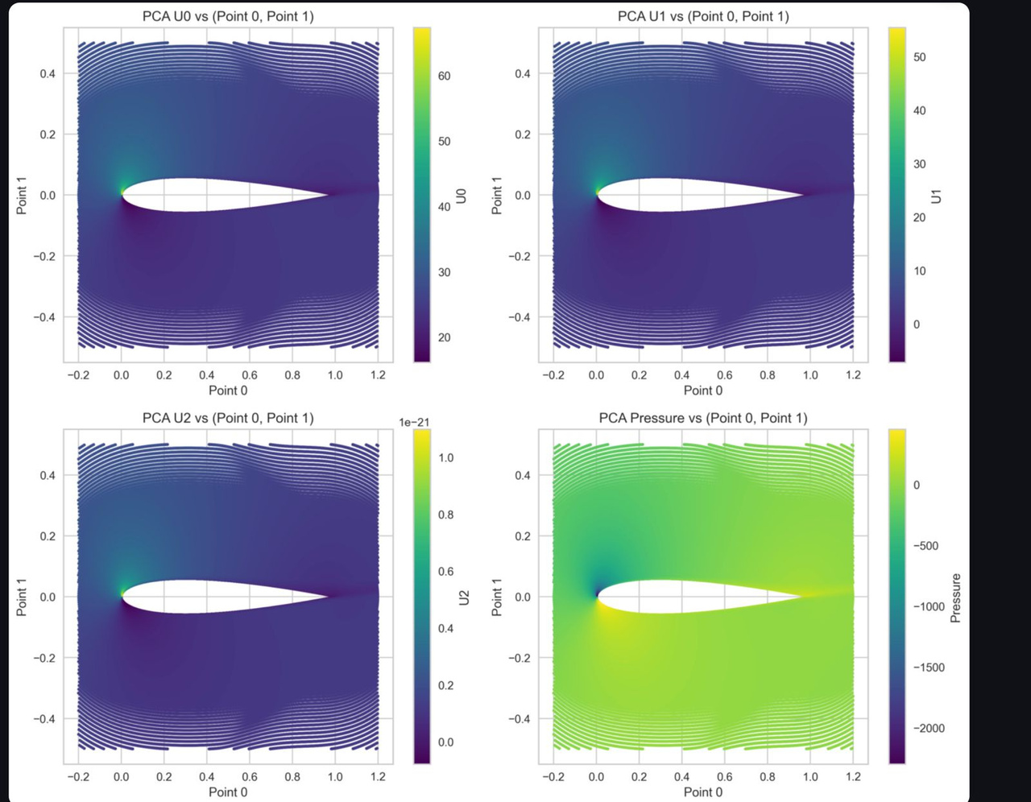
POST MODELLING

Slide 13
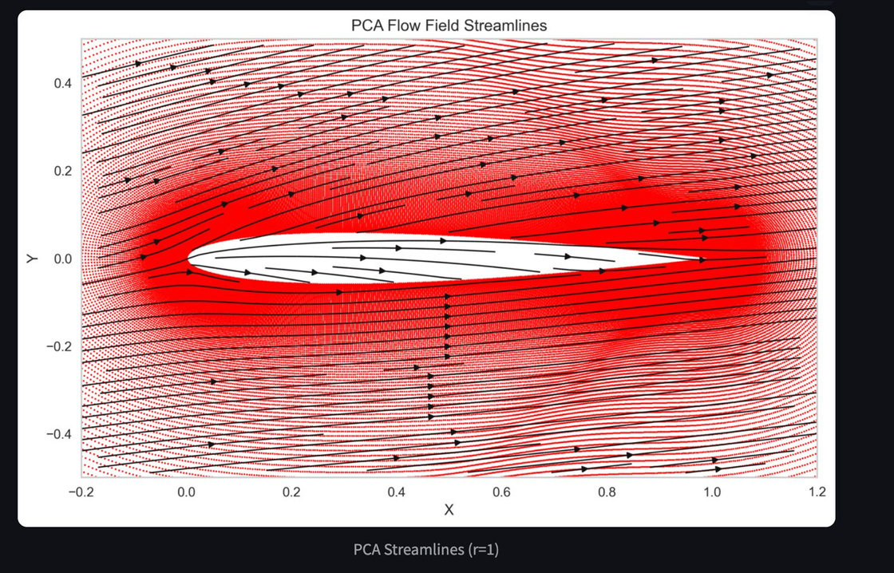
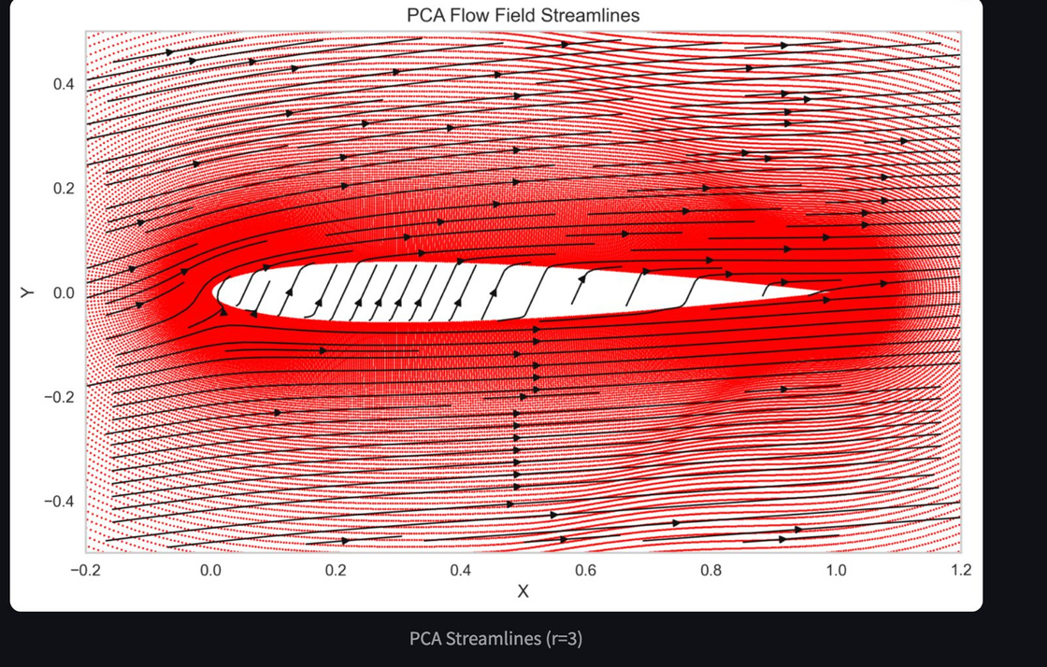
FLOW VISUALIZATION

Slide 14
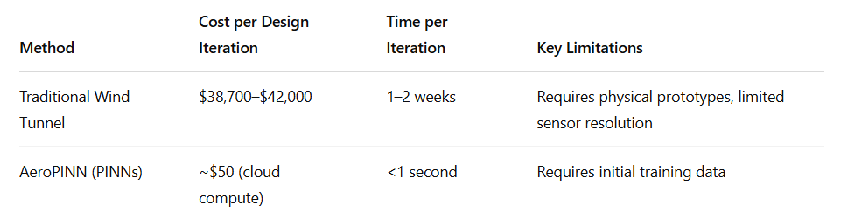
MuLTIDISCIPLINARY DIGITAL PUBLISHING INSTITUTE STUDY
PINNs reduce wind load analysis costs by 92%
For 100 airfoil design iterations, savings reach $4.2M

Slide 15
DATASET
CFD simulation results for six airfoil shapes: NACA 0012, 0015, 0021, 2412, 2415, 4412
Data provided in CSV format
Includes pressure coefficient values (p)
Includes velocity components (U:0, U:1, U:2)
Includes 3D coordinates of airfoil points (Points:0, Points:1, Points:2)
Link: A black hole is a region of space where gravity is so strong that nothing can escape.

Slide 16

ACHIEVEMENTS
Positive feedback from xgxg1314 (Learn2Learn), starred and liked our GitHub project within 10 mins of uploading the project
Link: https://github.com/xgxg1314

Slide 17
THANKYOU

